Slide 1
GE Dishwasher Teardown Report
Jude Elkins, Joshua Orlett, Mike Fallen

Slide 2
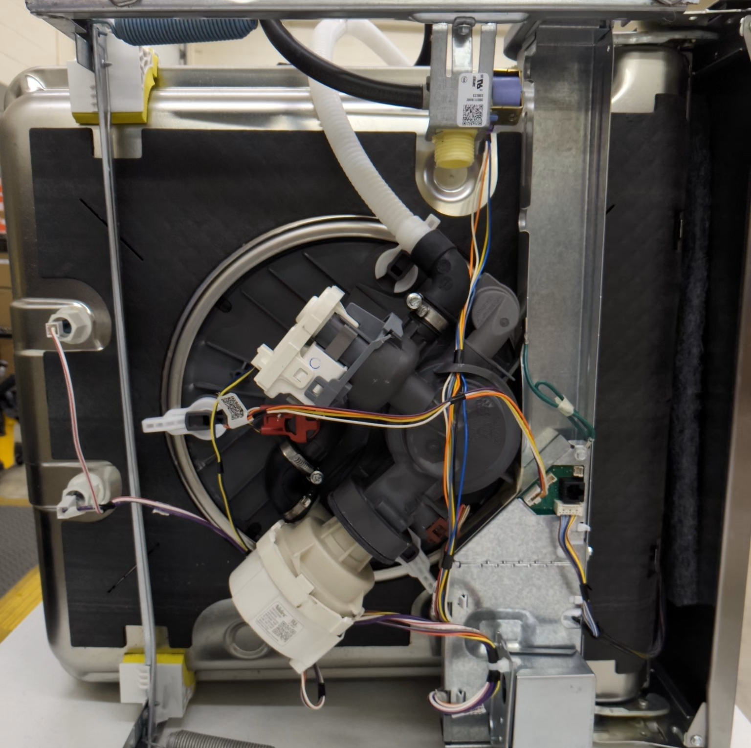
Components

Slide 3
Component List
Sump
Distribution Cap & Valve Mechanism
Sensors
Circulation Motor
Drain Motor
Inlet valve

Slide 4
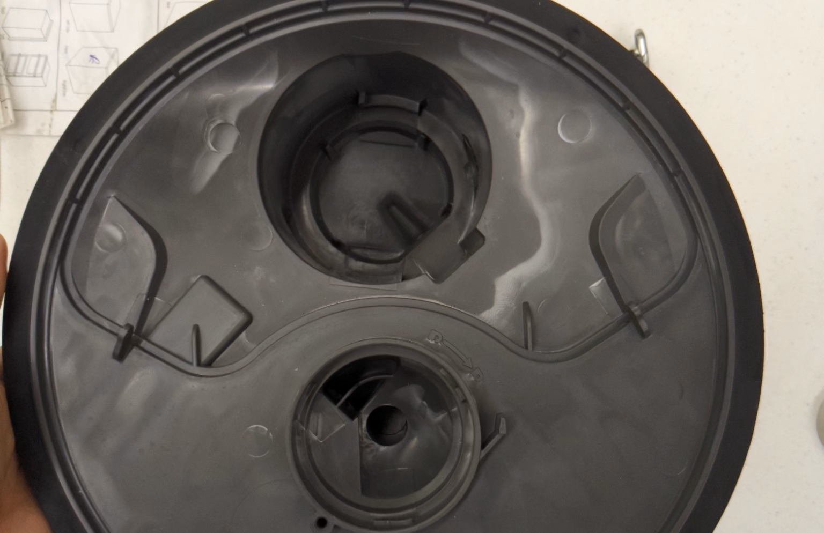
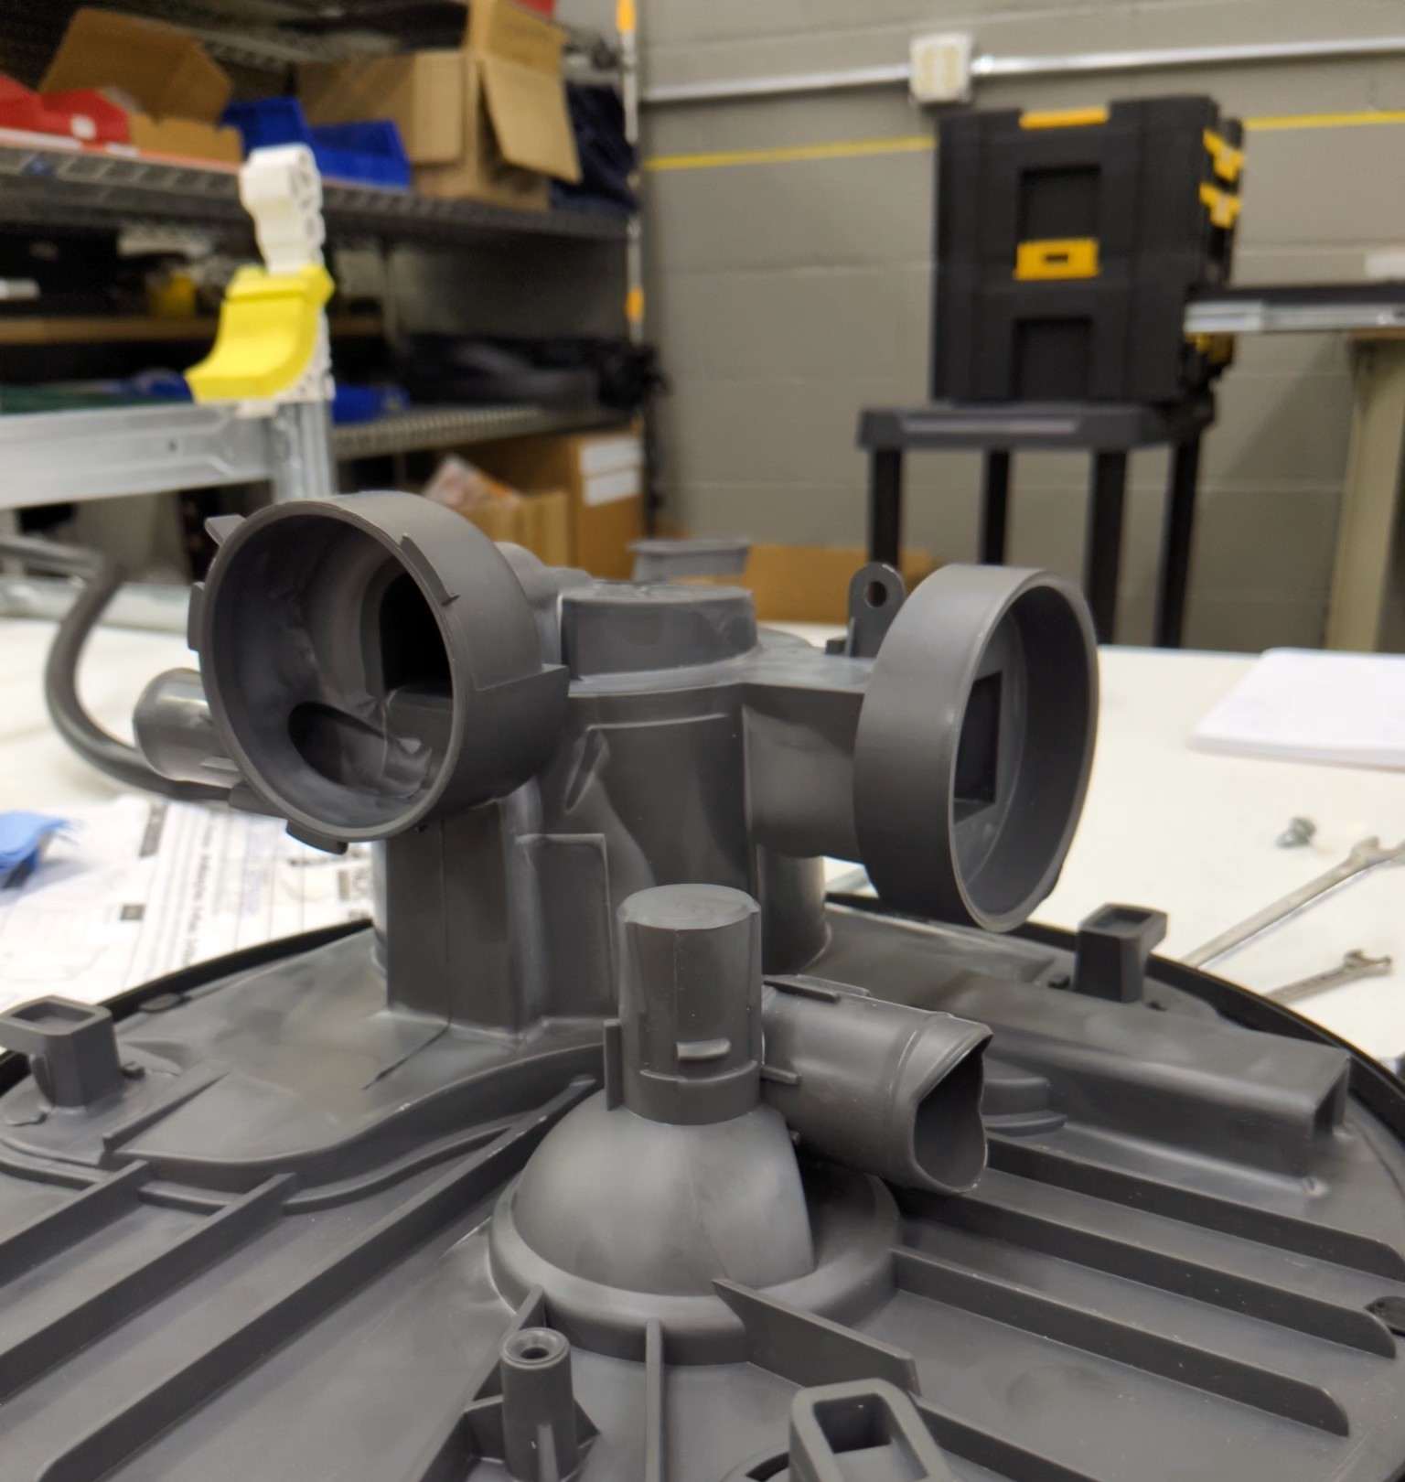
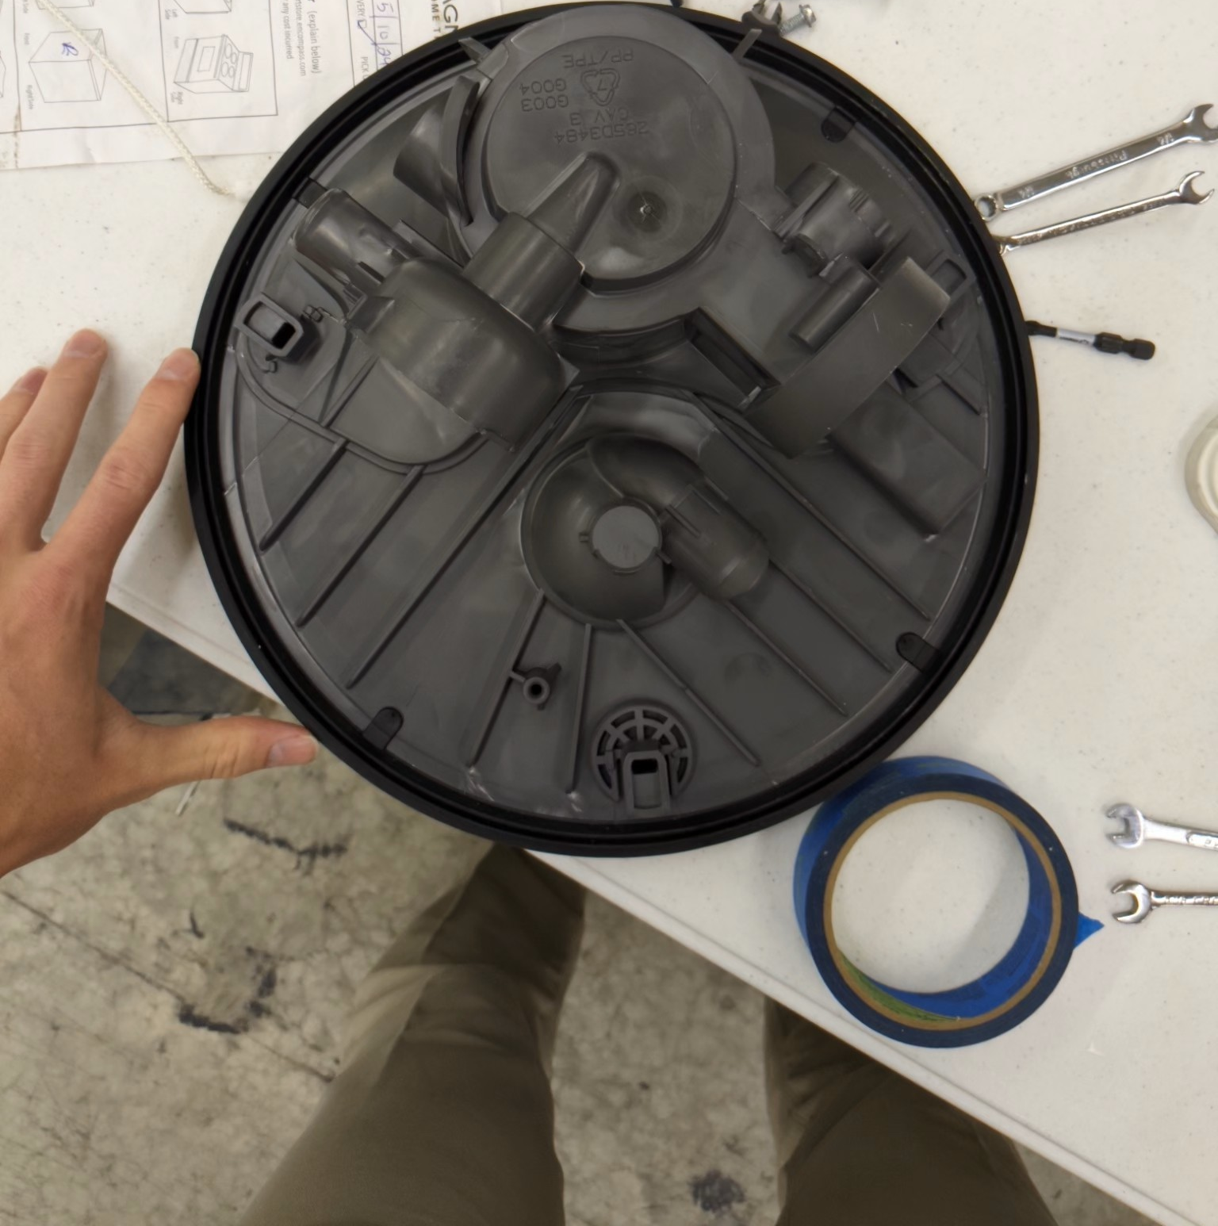
Sump
B
A
The sump is the large plastic plate that all other components connect to.
One main (inlet) hole and one outlet.
All water intake to the pumps is handled through the single drain hole.
The top of the sump showing the Drain hole (red) and Outlet (Green)
C
The Bottom of the sump showing the attachment for the Circulation pump (A) Drain pump (B) and the inlet for the distribution cap (C)

Slide 5
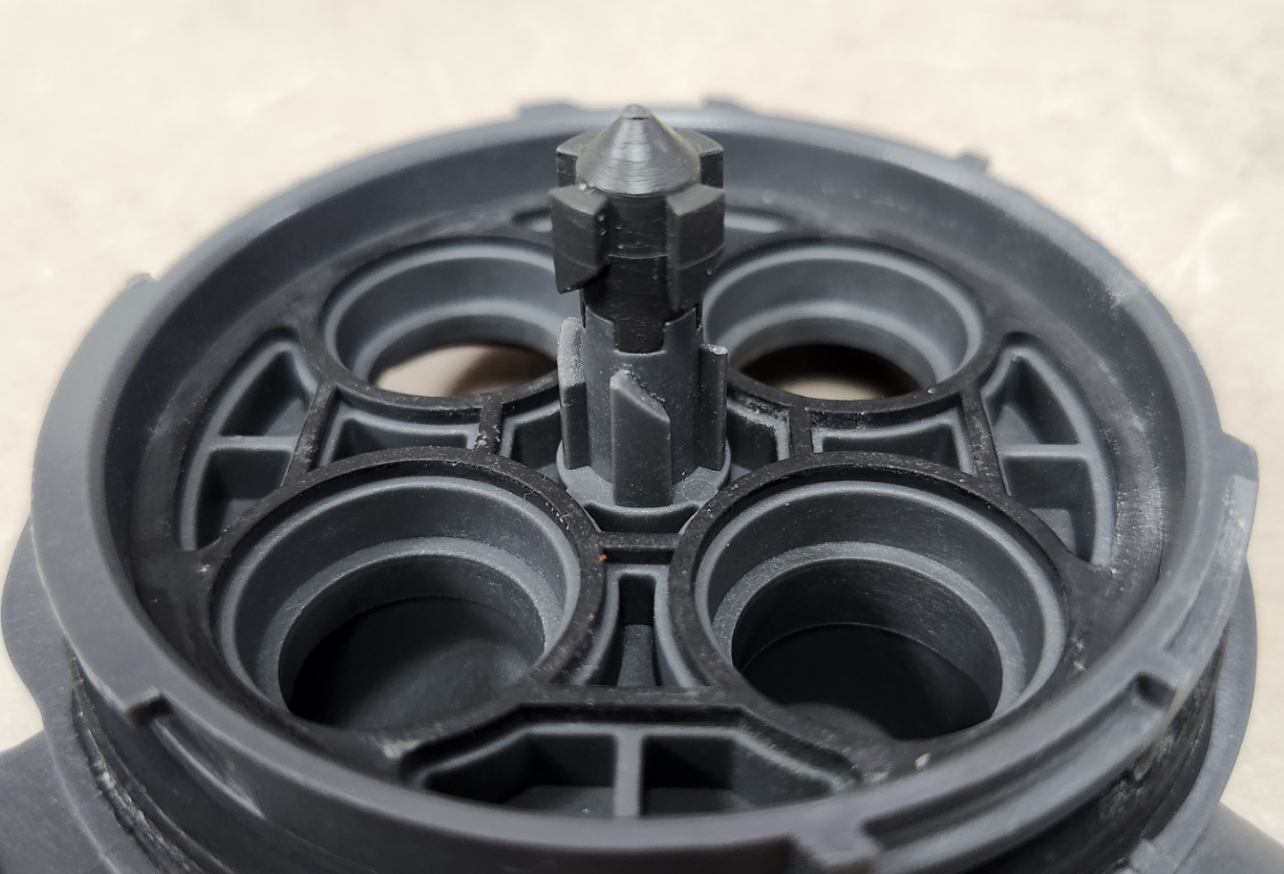
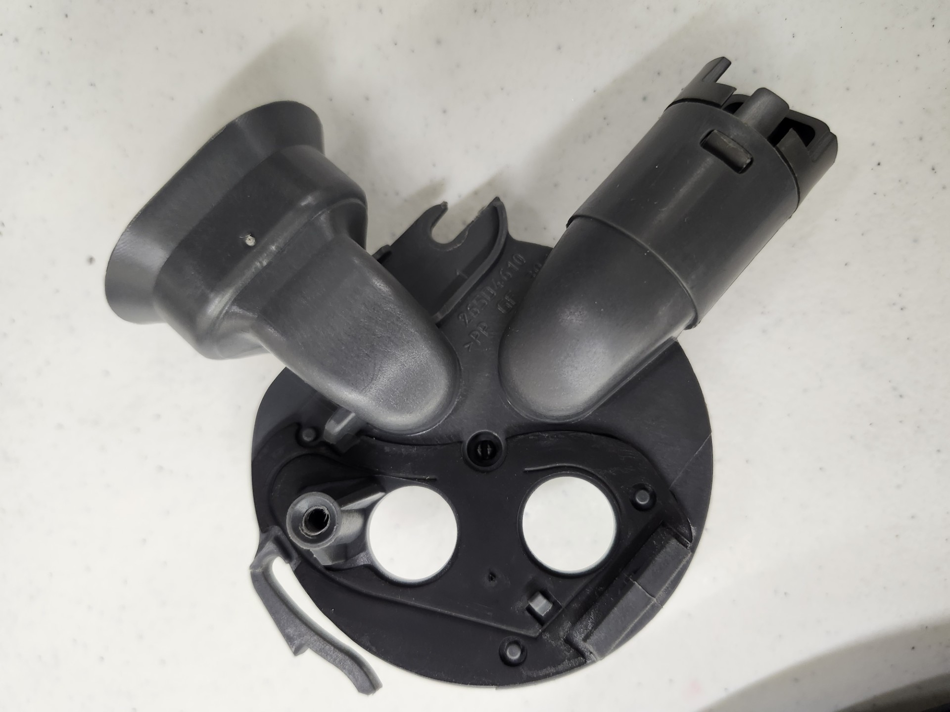
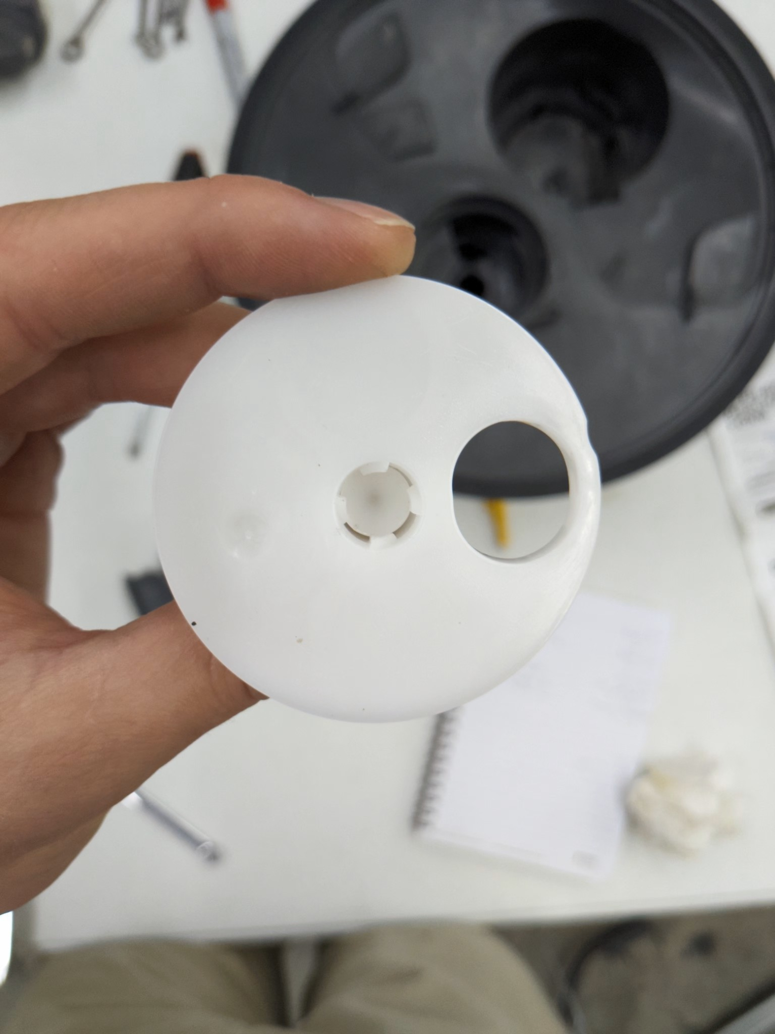
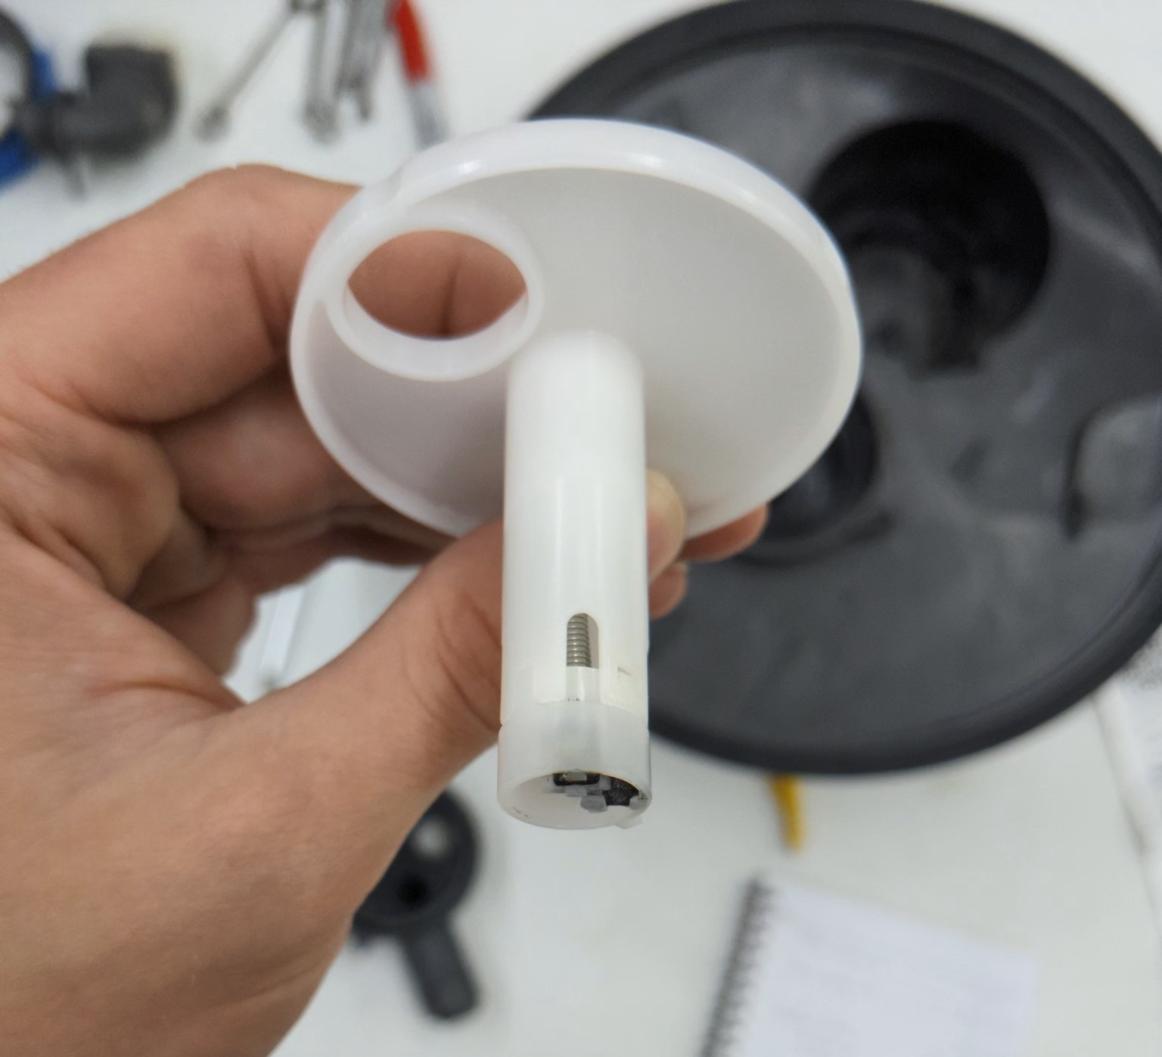
Distribution Cap and Valve
A
C
B
The cam mechanism on the bottom of the distribution cap and inside of the valve
The Distribution cap has 4 outlet holes that lead to various parts of the dishwasher.
The white valve uses a pen like cam mechanism to rotate the hole to one of the four on the cap.
The Cap has four outlets, two to the bottom spray head, one to the top spray head, and one that sprays toward the silverware.
The four outlets bottom sprayer(A) silverware (B) top sprayer(C)
The spring and magnets in the valve

Slide 6
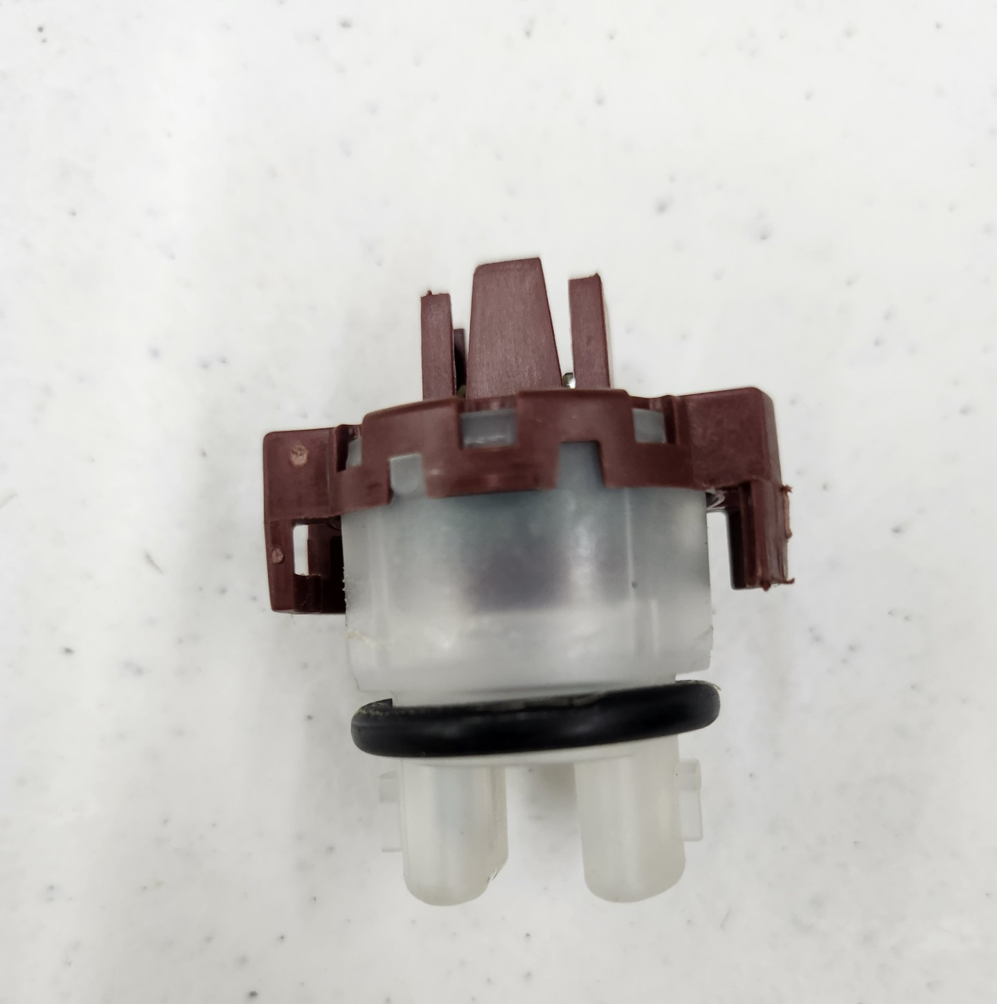
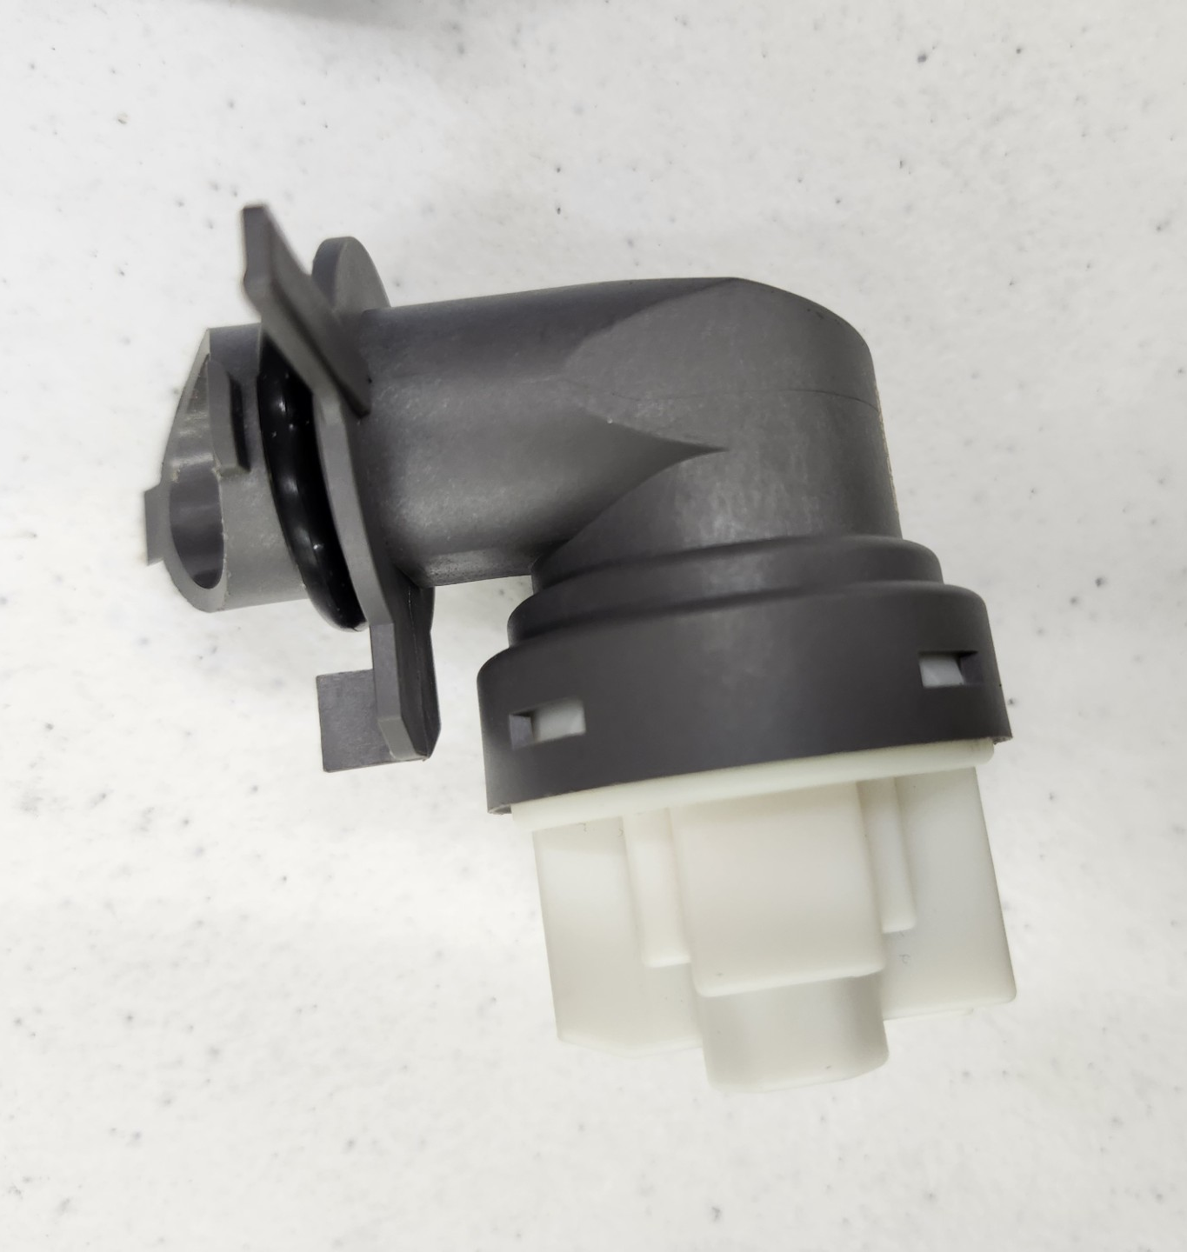
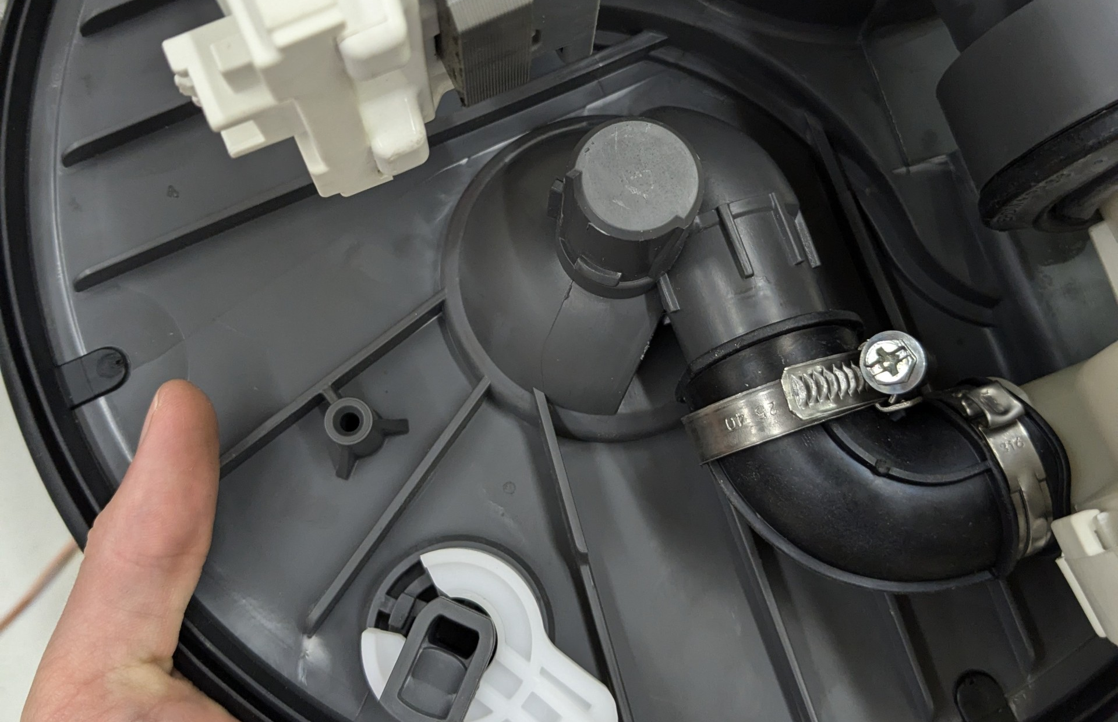
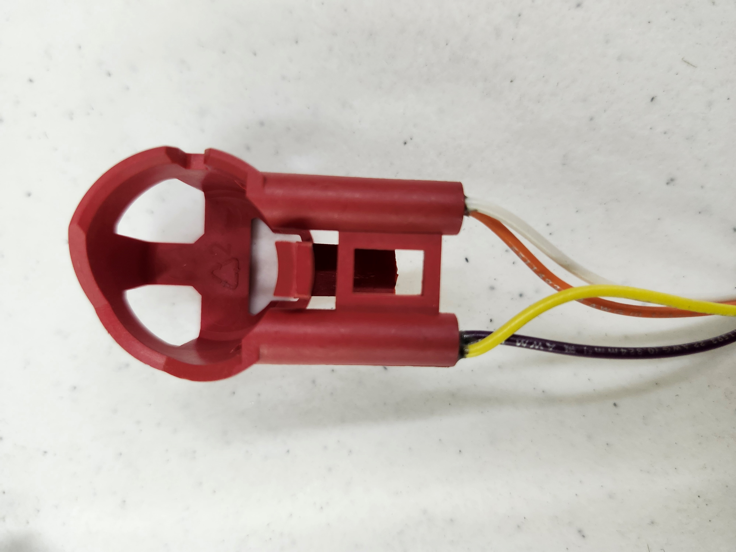
Sensors
We found three sensors on the sump.
A turbidity and temperature sensor.
The Pressure sensor.
Magnetic sensor for the position of the distribution valve.
Turbidity Sensor
Pressure Sensor
Post for Magnetic Sensor
Magnetic Sensor

Slide 7
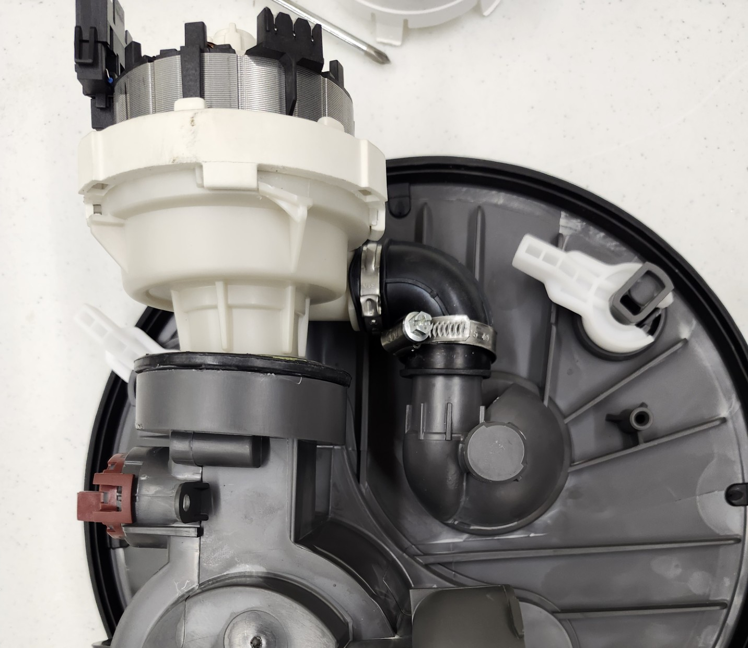
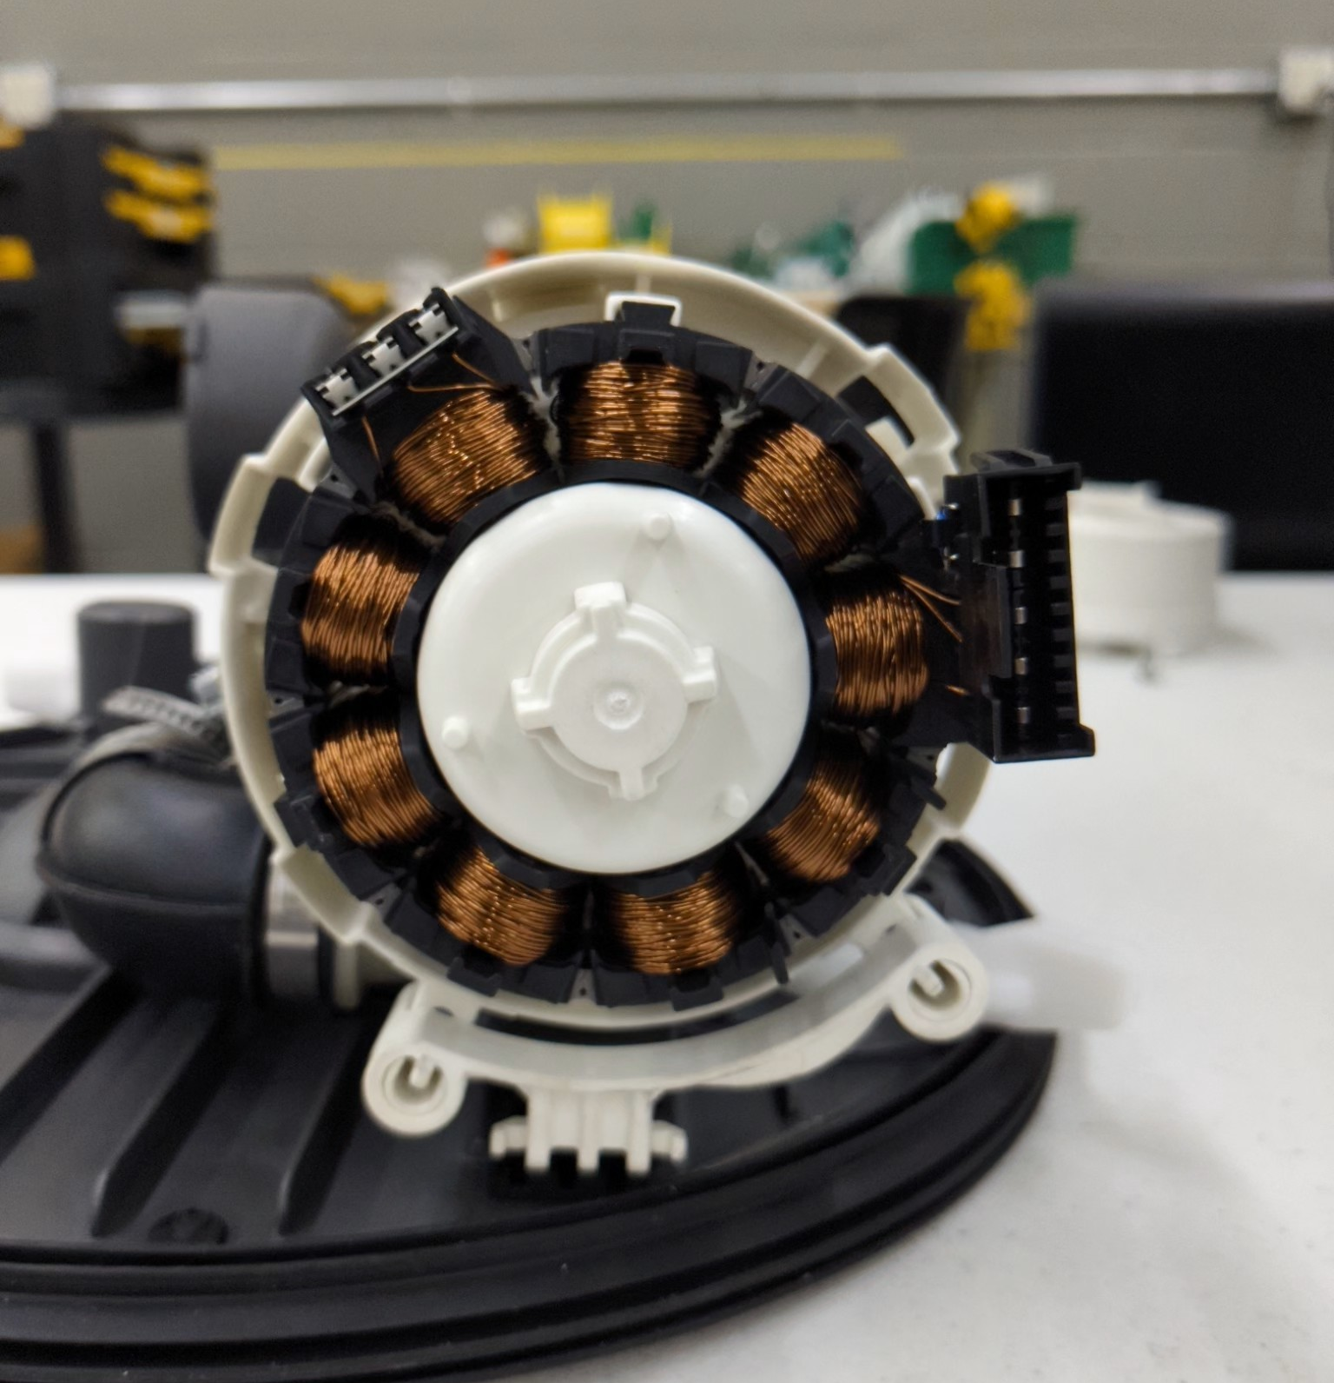
Circulation Pump
We did not remove the pump as it was sealed into the sump, and we did not want to break it.
The pump takes water in from the main hole in the sump and outputs through the distribution cap.
BLDC motor

Slide 8
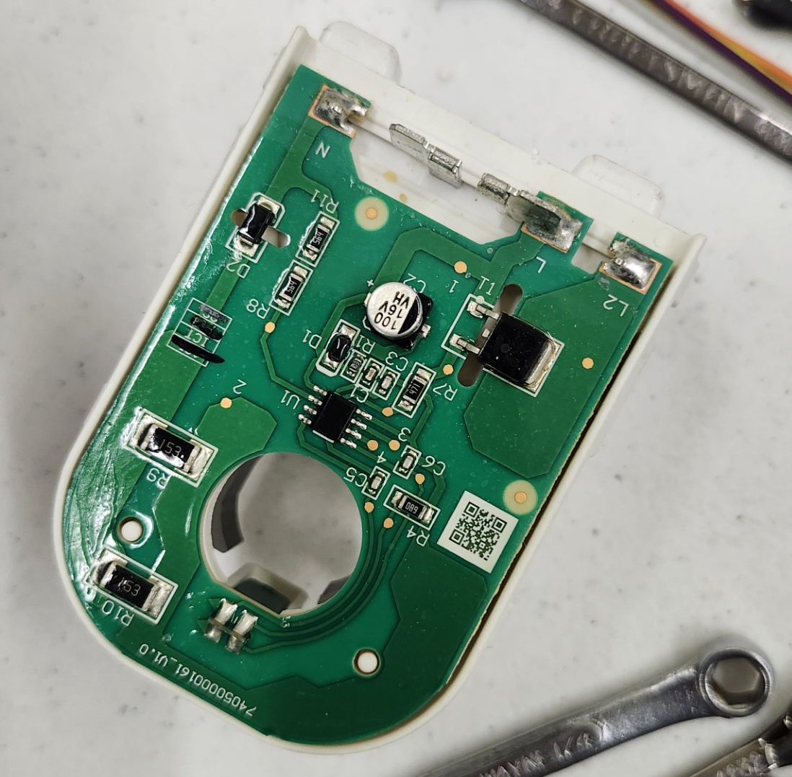
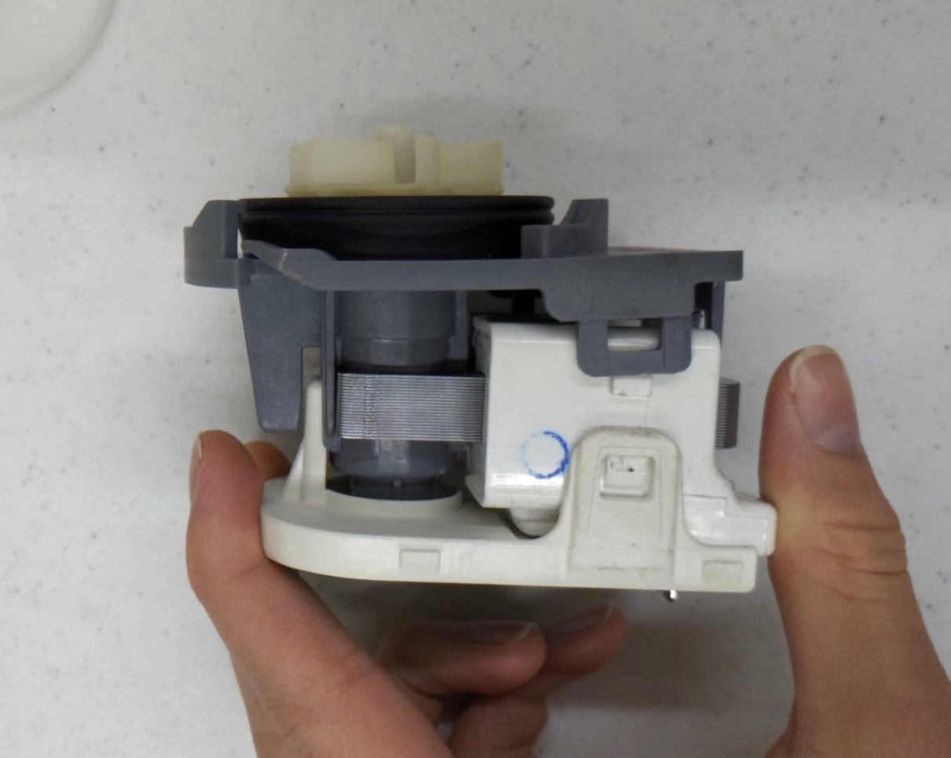
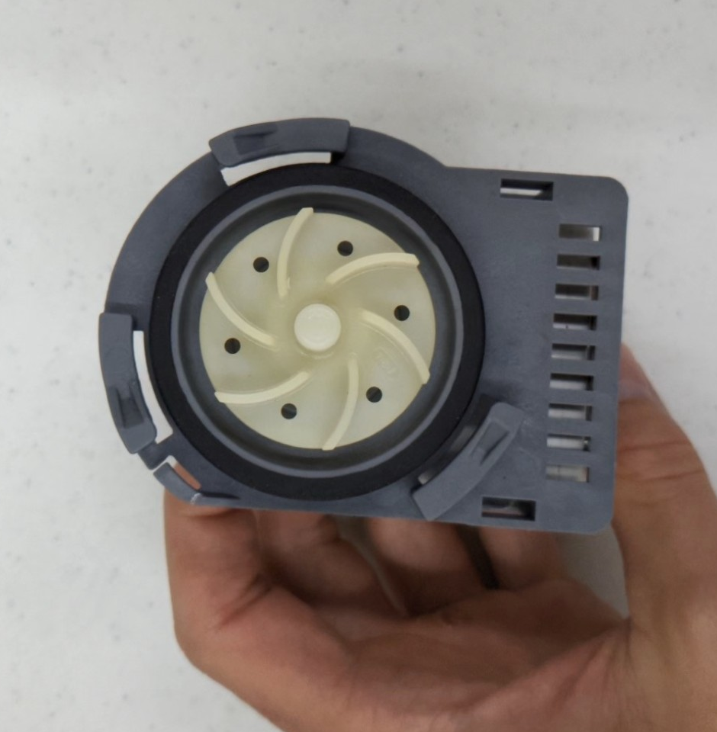
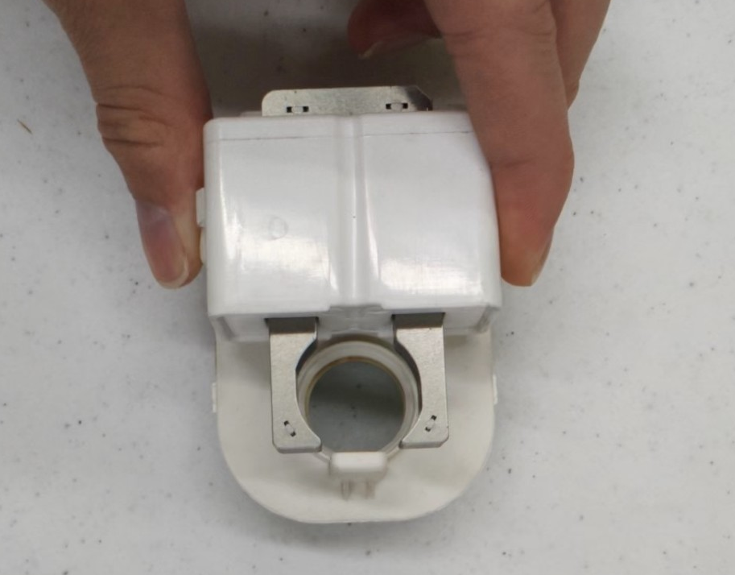
Drain Pump
The drain pump takes water in from the main sump hole and then outputs through the drain hose.
AC Laminated motor with attached PCB
Pump with impeller attached
PCB Controller
Impeller
Motor with impeller removed

Slide 9
Flow Diagram
Water line
Pressure sensor
Position sensor
Inlet
Bottom Spray head
Turbidity sensor
Sump
Distribution Cap
Circ Pump
Silverware Spray
NOTE: The distribution cap can only output to one of the three at a time
Top Spray head
Drain
Drain Pump

Slide 10
Improvement Ideas
Improvement of the distribution cap mechanism
Eliminates drain pump
Will have to index between options but potential for multiple at once
Diverter valve on the circulation pump
Eliminates drain pump
Can toggle between or do both at once

Slide 11
Flow Diagram (Improved Distro Cap)
Water line
Pressure sensor
Position sensor
Inlet
Bottom Spray head
Turbidity sensor
Sump
Distribution Cap
Circ Pump
Silverware Spray
Top Spray head
Drain

Slide 12
Flow Diagram (Added Diverter Valve)
Water line
Pressure sensor
Position sensor
Inlet
Bottom Spray head
Turbidity sensor
Sump
Distribution Cap
Circ Pump
Silverware Spray
Diverter Valve
Drain
NOTE: The distribution cap can only output to one of the three at a time
Top Spray head

